Slide 1
Object-Oriented Programming (OOP)
Week – 04
Feb 10-14, 2019
Instructor: Basit Ali
Email: basit.jasani@nu.edu.pk
Object-Oriented Programming (OOP)

Slide 2
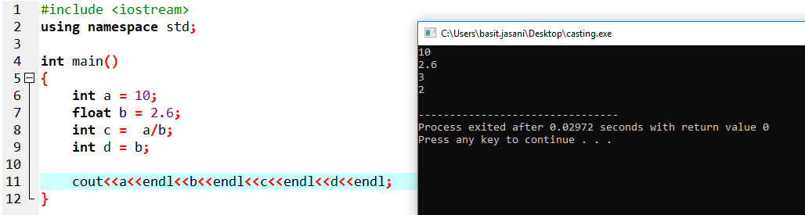
Type Casting
Converting an expression of a given type into another type is known as type-casting

Slide 3
Types of Type-Casting
Implicit conversion
Implicit conversions do not require any operator
Perform by the compiler automatically
Explicit conversion
Perform by the programmer
Data loss might occur

Slide 4
Implicit Casting

Slide 5
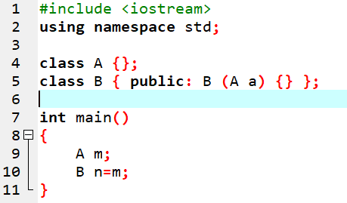
Implicit Casting
Implicit conversions also include constructor or operator conversions, which affect classes that include specific constructors or operator functions to perform conversions
For example →
Here, an implicit conversion happened
between objects of class A and class B,
because B has a constructor that takes
an object of class A as parameter.

Slide 6
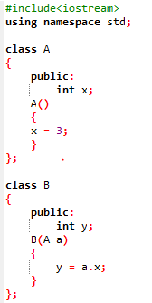
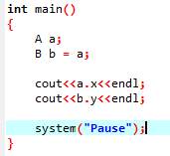
Implicit Casting (Example)

Slide 7
Explicit Casting
User defined typecast for the result to make it to a particular data type
In C++, it can be done by two ways:
By Assignment Also known as forceful casting where type indicates the data type to which the final result is converted.
By cast Operator A Cast operator is an unary operator which forces one data type to be converted into another data type.

Slide 8
Explicit Casting
Syntax: (type_name) expression/value Or Type_name (expression/value)
Example: Float f = 15.65; int a; a= (int) f;
Or
a = int(f);

Slide 9
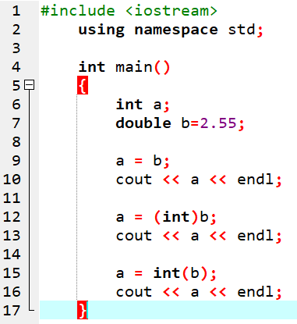
Explicit Casting
Note: the output of all cout statements is 2.
The first conversion is an implicit conversion (the compiler decides.) As explained before, the compiler should give a warning.
The second conversion is an explicit typecast, in this case the C style explicit typecast.
The third conversion is also explicit typecast, in this case the C++ style explicit typecast.

Slide 10
Explicit Casting (Typecast Operator)
The C++ language has four typecast operators:
static_cast
const_cast
reinterpret_cast
dynamic_cast
Note: We will cover these topics after inheritance.

Slide 11
Static Members of a C++ Class
We can define class members static using static keyword.
When we declare a member of a class as static it means no matter how many objects of the class are created, there is only one copy of the static member.
A static member is shared by all objects of the class.

Slide 12
Static Members of a C++ Class
It can be initialized outside the class using the scope resolution operator :: to identify which class it belongs to.
All static data is initialized to zero when the first object is created, if no other initialization is present.

Slide 13
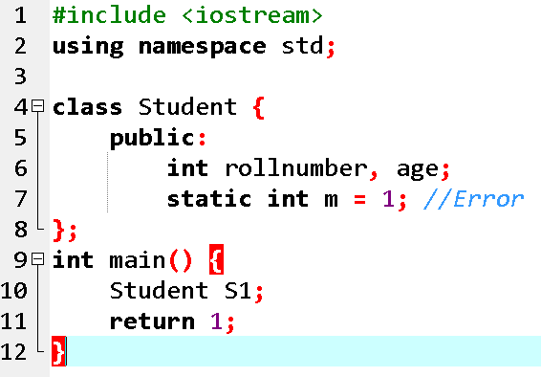
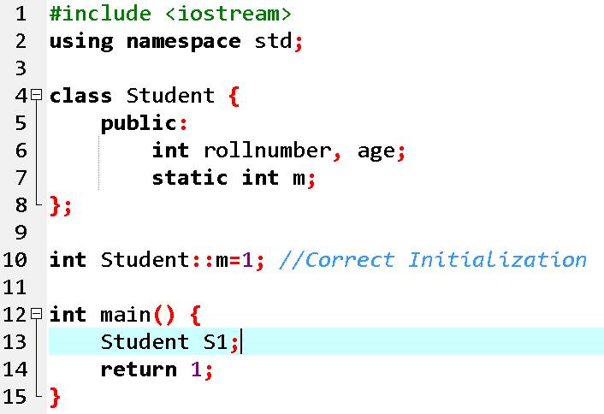
Concept: Static Members can be initialized outside the class

Slide 14
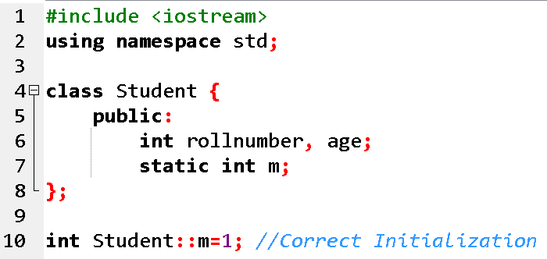
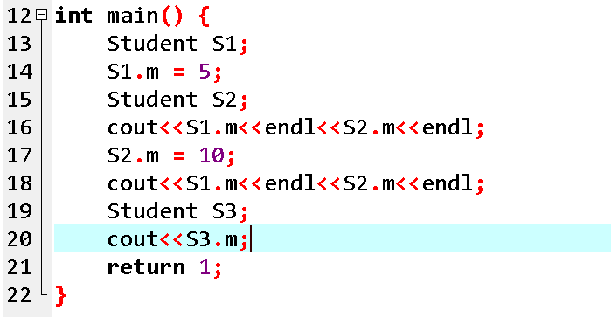
Concept: A static member is shared by all objects of the class

Slide 15
Static Member Functions of a C++ Class
By declaring a function member as static, you make it independent of any particular object of the class
A static member function can be called even if no objects of the class exist and the static functions are accessed using only the class name and the scope resolution operator ::.

Slide 16
Static Member Functions of a C++ Class
A static member function can only access static data member, other static member functions and any other functions from outside the class.

Slide 17
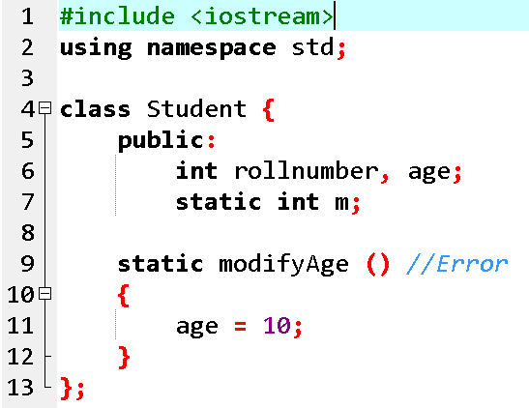
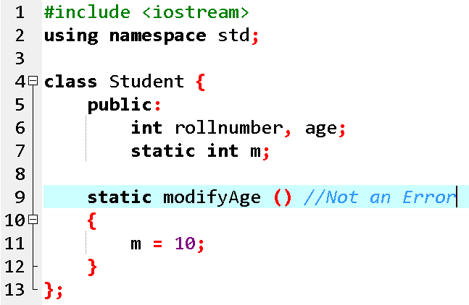
Concept: A static member function can only access static data member

Slide 18
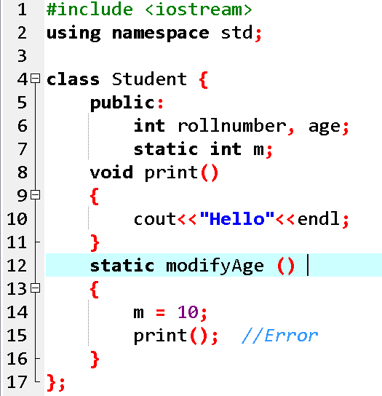
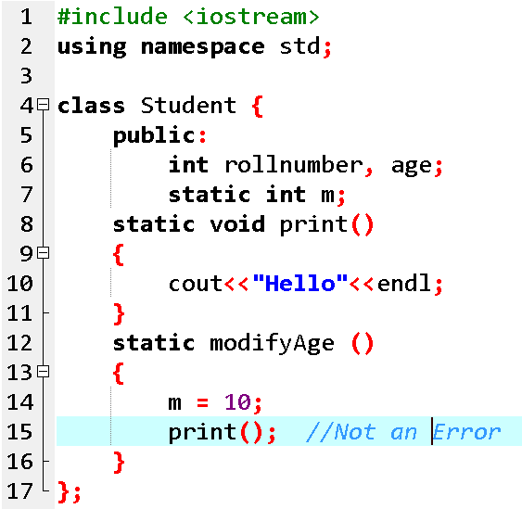
Concept: A static member function can only access other static member functions

Slide 19
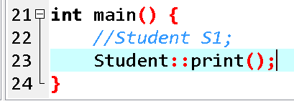
Concept: A static member function can be called even if no objects of the class exist

Slide 20
const Keyword in C++
Constant is something that doesn't change.
In C language and C++ we use the keyword const to make program elements constant.
const keyword can be used in many contexts in a C++ program. It can be used with:
1) Variables 2) Pointers 3) Function arguments 4) Class Data members 5) Class Member functions 6) Objects

Slide 21
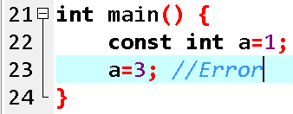
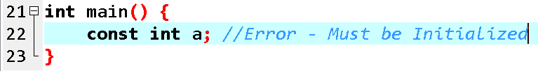
1) Constant Variables in C++
If you make any variable as constant, using const keyword, you cannot change its value. Also, the constant variables must be initialized while they are declared.

Slide 22
2) Pointers with const keyword in C++
Pointers can be declared using const keyword too.
When we use const with pointers, we can do it in two ways, either we can apply const to what the pointer is pointing to, or we can make the pointer itself a constant.

Slide 23
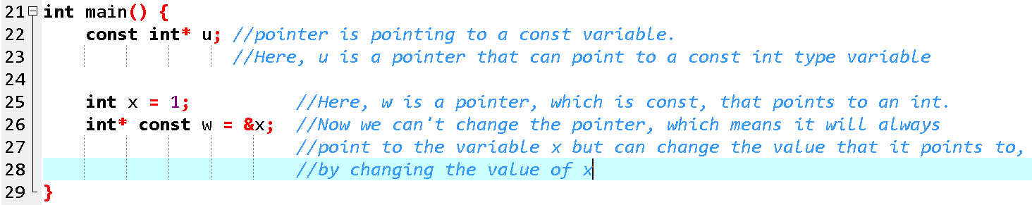
2) Pointers with const keyword in C++

Slide 24
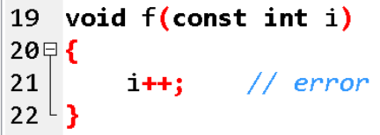
3) Function with constant Arguments
We can make the arguments of a function as const. Then we cannot change any of them.

Slide 25
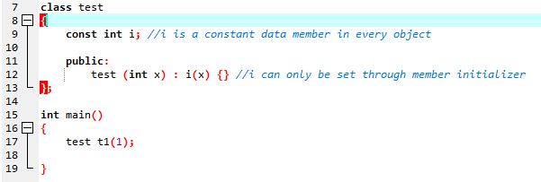
4) Defining Class Data members as const
These are data variables in class which are defined using const keyword. They are not initialized during declaration. Their initialization is done in the constructor.

Slide 26
5) Defining Class Object as const
When an object is declared or created using the const keyword, its data members can never be changed, during the object's lifetime.
Syntax:
const class_name object;

Slide 27
6) Defining Class's Member function as const
A const member function never modifies data members in an object.
Syntax:
return_type function_name() const;

Slide 28
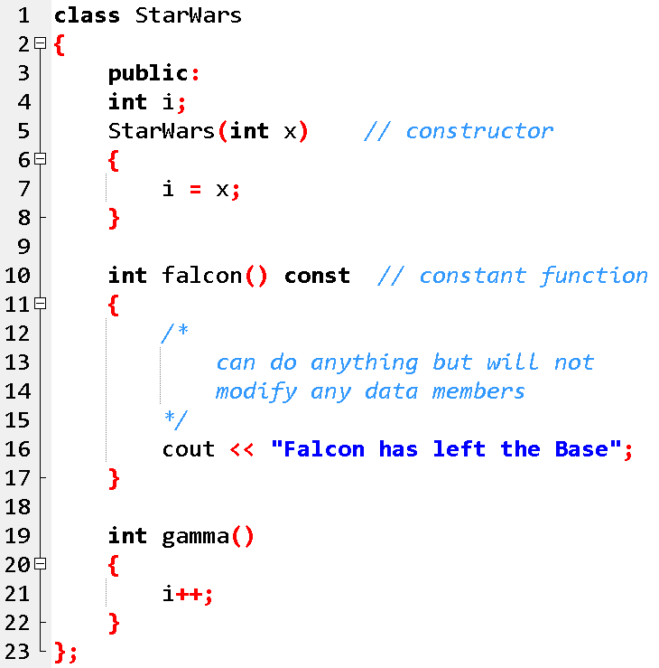
Example for const Object and const Member function

Slide 29
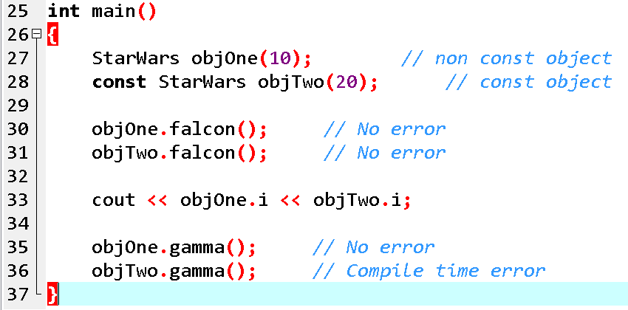
Example for const Object and const Member function

Slide 30
mutable Keyword
mutable keyword is used with member variables of class, which we want to change even if the object is of const type. Hence, mutable data members of a const objects can be modified.

Slide 31
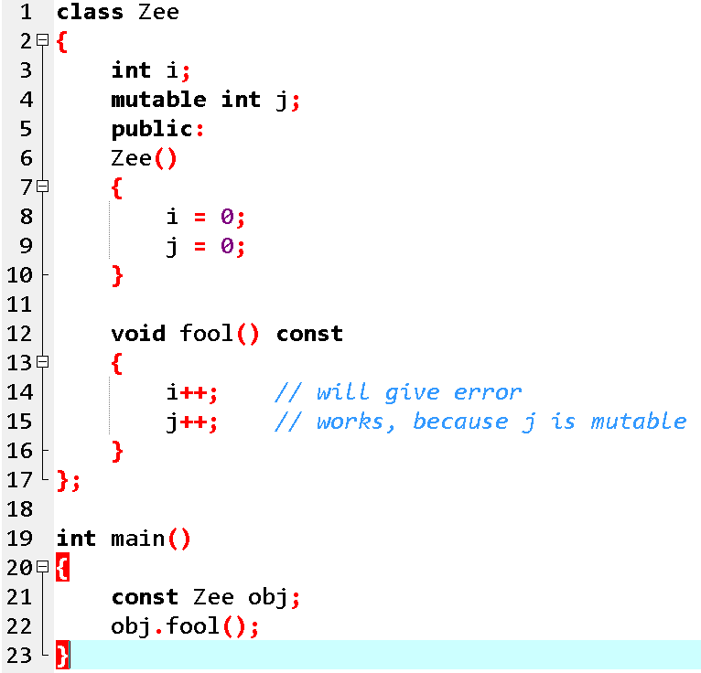
Example: Mutable

Slide 32
Reading Assignment!
Dietel, 7th Edition
Classes: A Deeper Look, Part 2
10.2 const (Constant) Objects and const Member Functions
10.6 static Class Members

Slide 33
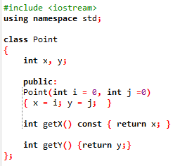
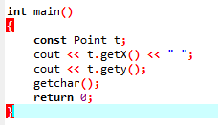
Exercise!

Slide 34
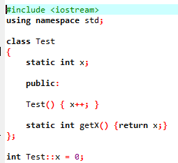
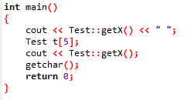
Exercise!

Slide 35
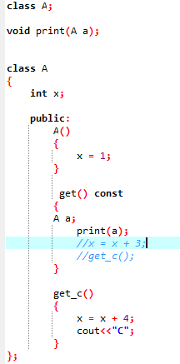
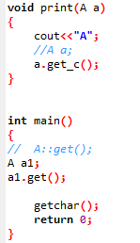
Exercise!

Slide 36
Saving Account Class
Create a SavingsAccount class. Use a static data member annualInterestRate to store the annual interest rate for each of the savers. Each member of the class contains a private data member savingsBalance indicating the amount the saver currently has on deposit. Provide member function calculateMonthlyInterest that calculates the monthly interest by multiplying the balance by annualInterestRate divided by 12; this interest should be added to savingsBalance. Provide a static member function modifyInterestRate that sets the static annualInterestRate to a new value. Write a driver program to test class SavingsAccount. Instantiate two different objects of class SavingsAccount, saver1 and saver2, with balances of $2000.00 and $3000.00, respectively. Set the annualInterestRate to 3 percent. Then calculate the monthly interest and print the new balances for each of the savers. Then set the annualInterestRate to 4 percent, calculate the next month’s interest and print the new balances for each of the savers.

